Slide 1
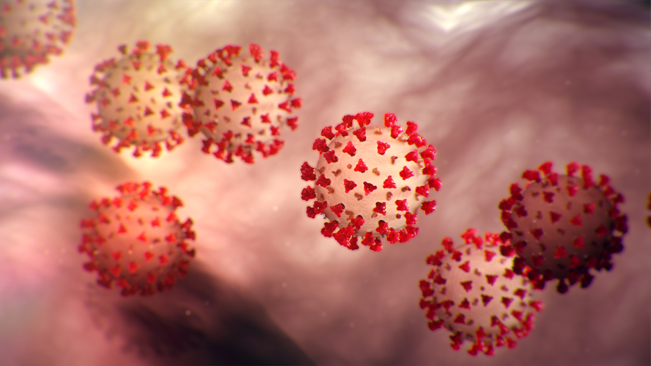
What is coronavirus?

Slide 2
What is coronavirus?
Coronaviruses are a type of viruses that we have been in contact before. They have been around for a while.
Common symptoms from coronavirus are fever, runny nose and a cough.

Slide 3
How is Covid-19 different?
Covid-19 is a novel virus.
That means it only recently made the jump from one species to humans.
It is “novel” or new. Humans have not been infected with this particular virus before.
jump from one species to another

Slide 4
How is Covid-19 different?
At some point it jumped to humans from an unknown animal.
Now there is human to human transmission.
jump from one species to another

Slide 5
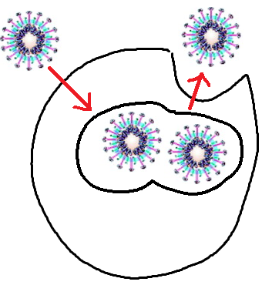
What does it do inside of your body
Like all viruses – this virus attacks your cells and takes over them.
It then uses your cells to make more viruses.
Your immune system will eventually catch up to the virus and fight it off.

Slide 6
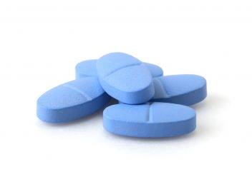
Are there medicines to take for this virus?
There are no anti-viral medications that can be used to treat this new virus.
Most medicine is to treat the symptoms that arise from secondary infection that you develop after catching the virus.

Slide 7
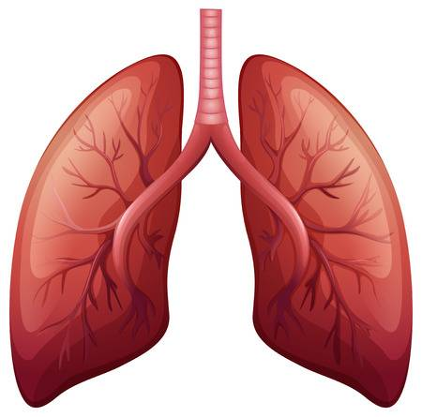
What are the symptoms of COVID-19?
Fever
Muscle pain
Sore throat
Dry cough
Breathing difficulty (later in the infection)

Slide 8
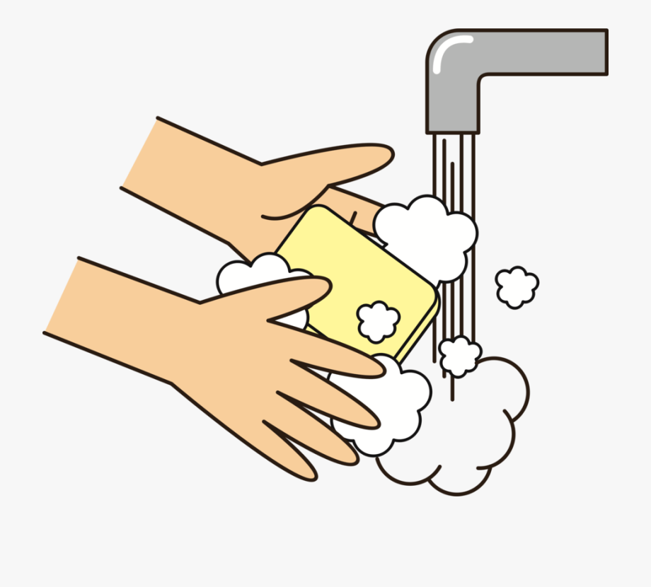
What is the best way to avoid catching COVID-19?
Hand washing for 20-25 seconds – especially before eating.
An alcohol based hand sanitizer can be used but they can dry out your hands over time.
Avoid touching your face, eyes and mouth.

Slide 9
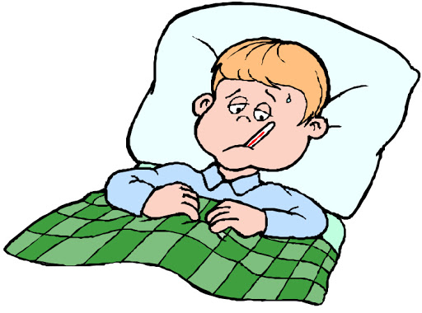
How do we keep it from spreading?
Stay home!
Visit a doctor if you start to feel very sick. Be sure to call the doctor first to determine where you should seek medical treatment.

Slide 10
Facts about COVID-19
The most affected individuals are those who are over 70 years of age.
Individuals who have other health issues: cancer, respiratory issues, diabetes may also have complications.
Most people will experience MILD symptoms – much like a cold.
FACTS!

