Slide 1
You…and some new changes
A workshop on puberty

Slide 2
General Hygiene- Suds Up - Hands and Body

Slide 3
The next slide is a video that will explain the topic a little further.
Questions? Still wondering or need more explanation? Feel free to use the chat mode ( which you can type questions)
After the video, click the “raise your hand button” and I will answer your questions

Slide 4
Menstrual Cycle

Slide 5
How feminine protection works…
Using water, I will show how pads absorb and adhere to under garments. I will also show how to dispose of them.
- A quick explanation on tampons

Slide 6
Anatomy- The female parts
This Photo by Unknown Author is licensed under CC BY-NC-ND

Slide 7
Girl Glossary
Using the Quizlet link below, test your understanding of some important words to know as you enter the world of puberty
https://quizlet.com/_8g367g?x=1jqt&i=u04s3
Paige is going to show you how to play

Slide 8
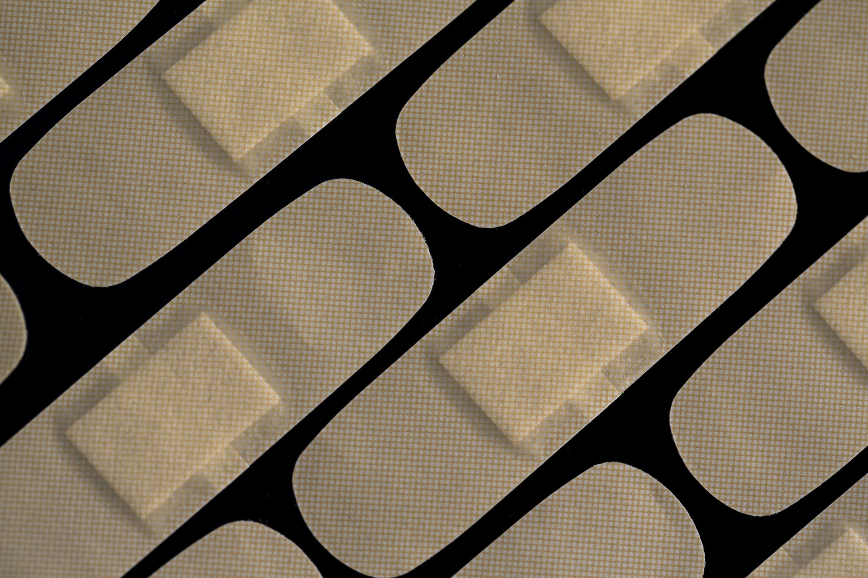
Hair
Hair on your arms and legs will get darker and sometimes thicker.
New hair will start growing under your arms and in your pubic area. Eventually they will become thick, dark and curly. This is known as pubic hair.
Body hair can BOOST body odor. It traps sweat and the warmth produces bacteria that can smell. Once you notice hair growing you should shower daily.
Check with your parents to try out a deodorant or anti- perspirant.
Do not shave without asking your parents first.
Shaving needs guidance and it also make the hair thicker and coarser.

Slide 9
Sleep and exercise
Your body will require more sleep as you go through puberty. Remember when you were younger, and you used to wake up your parents? Well that will change if it hasn’t already. I will be harder to wake up in the mornings, so it is REALLY important that you go to bed at a decent hour, so you get at least 8 hours sleep. Often teens need 10 hours to not be grouchy

Slide 10
Book Talk- by Grace Fortier
https://flipgrid.com/s/a8b47dfb9507

Slide 11
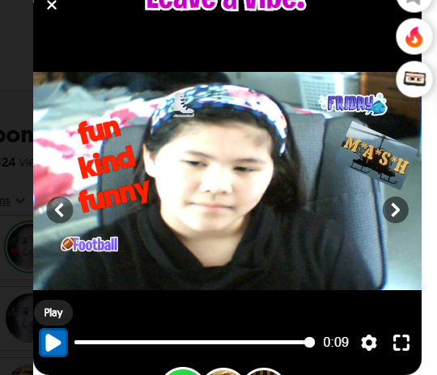
My Ah- Ha Moment-Try a Flip Grid
https://flipgrid.com/20b57fa4
Melissa will show you how to make one answering the 3 questions in the Flip Grid
Just FYI- It will automatically get sent to our private grade 5 girl’s channel. If you don’t want to do a flip grid you can send your responses or questions directly to my work email:
kboughton@lssd.ca

Slide 12
Resources Click the links for more information
https://www.amazon.ca/Care-Keeping-You-Revised-Younger/dp/1609580834
https://www.amazon.ca/dp/1609581830/ref=cm_sw_em_r_mt_dp_U_2pO1Eb3H5F4M2
Winnipeg Source
https://www.mcnallyrobinson.com/searchresults?txtSearchSearchType=keyword&txtSearchFulltextCriteria=the+care+and+keeping+of+you&txtSearchMode=sitewide

Slide 13
Thank you for joining today
Email questions to me at kboughton@lssd.ca
Submit your A-Ha moment Flip Grid before June 24th
My website is www.msbcounsellor.weebly.com
My Instagram page is instagram.com/msbcounsellor
Have a great summer girls, Ms B

